Slide 1
IRIS DATA ANALYSIS USING MACHINE LEARNING
Machine Learning Intermediate Project

Slide 2
Context
The species of Iris (namely Iris-setosa, Iris-versicolor and Iris-virginica) can be determined with the help of its features, namely, sepal length, sepal width, petal length and petal width.
The aim of this project is to use the different modelling techniques to determine which of these features can be best used to identify the species.

Slide 3
Overview of the Dataset
The iris dataset comprises of 50 samples each for the 3 different species, namely, Iris-setosa, Iris-versicolor and Iris-virginica.
The dataset also consists of the measurements in terms of sepal length (cm), sepal width (cm), petal length (cm) and petal width (cm).

Slide 4
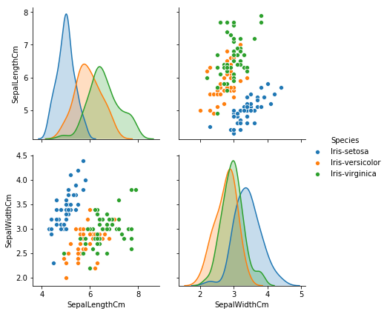
Relationship between Sepal Length and Sepal Width
We can see that Sepal Length and Sepal Width features are slightly correlated with each other.

Slide 5
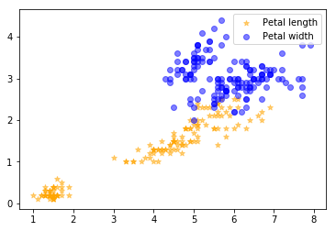
Relationship between Petal Length and Width
There is a clear correlation between Petal length and width features .

Slide 6
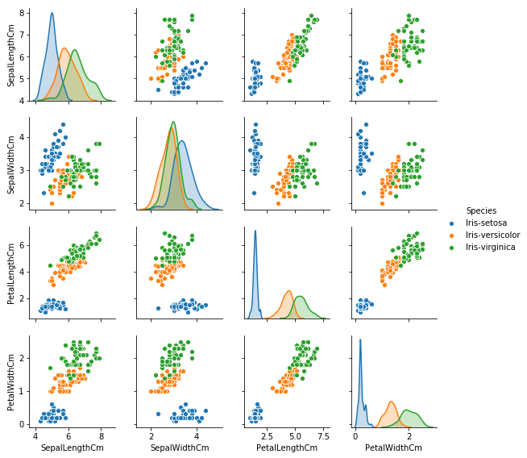
Relationship - Sepal Length, Sepal Width. Petal Length and Petal Width
There is a clear correlation between Petal features and type of species.
The Petal Features are giving a better cluster division compared to the Sepal features. This indicates that the Petals can help in better and accurate Predictions over the Sepal.

Slide 7
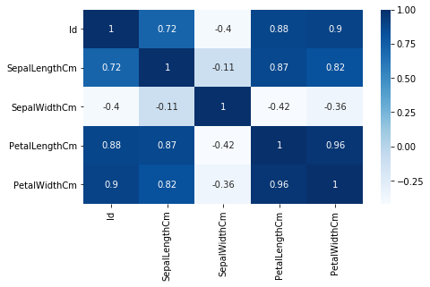
Correlation matrix
The Petal Width and Length are highly correlated whereas the Sepal Length and Width show weak correlations.

Slide 8
Modelling the data
We have used the following algorithms to calculate the training and testing accuracy of Petal and Sepal:
Decision tree
Logistic Regression
K-Nearest Neighbors
Support Vector Machine

Slide 9
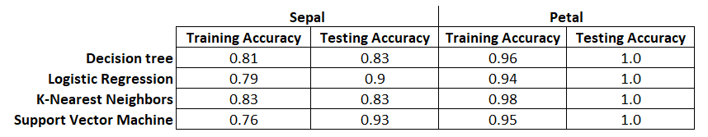
Results and Conclusion
The training and testing accuracy of Petal and Sepal for each of the models is as below
Using Petals over Sepal for training the data gives a much better accuracy.
From the results above, we can conclude that Petal Length and Width are the best features to identify the species of Iris.

Slide 10
References
www.Kaggle.com

